Slide 1
Using Principal Stratification to Detect Mode Effects in a Longitudinal Setting
Wenshan Yu, Michael Elliott, Trivellore Raghunathan
Notes:
Hello everyone, welcome to the presentation. Today I’m going to talk about using principal stratification to detect mode effects in a longitudinal setting

Slide 2
Motivation
The primary focus of longitudinal studies is to measure changes
Measurement error remains constant across waves
Different mixed-mode designs across waves may void the assumption
Accounting for the design differences across waves is challenging
Different modes have distinct representation properties
We use principal stratification and potential outcome framework in this study
Principal stratification is commonly used to adjust for post-treatment covariate
View assigned mode of data collection as the treatment
Consider whether responding to a mode as the post-treatment covariate
Notes:
The primary focus of longitudinal studies is to measure changes. To achieve this aim, we need to assume that measurement error remains constant across waves. However, by using different mixed-mode designs across waves, we may violate the assumption, which brings challenges to making longitudinal inferences.
On the other hand, accounting for this design difference in longitudinal studies can be challenging. Because each mode also has different representation properties, meaning that we may be dealing with different people in different waves, which is often considered as mode selection effects. How to isolate the mode measurement effects from the mode selection effects is the critical challenge here.
In this study, we use potential outcome framework and principal stratification to address the challenge. Principal stratification is commonly used to adjust for post-treatment covariate in causal inference. Here we view mode of data collection as a treatment and consider whether responding to a mode is the post-treatment covariate to be adjusted for. This way, we can create strata based on whether Rs can participate via the mode and make apple-to-apple comparisons to control for any selection effects.

Slide 3
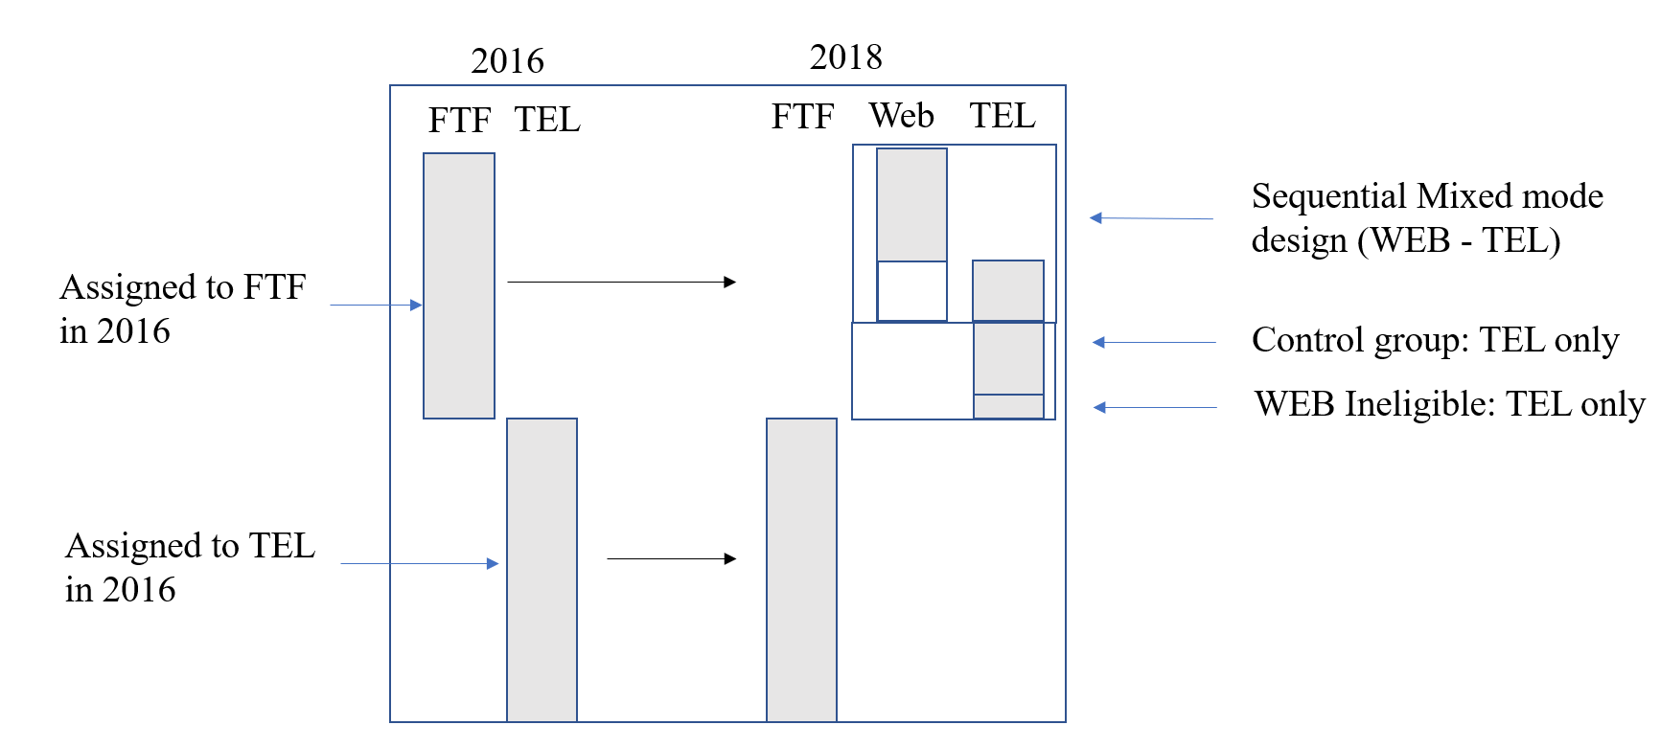
Data：Health and Retirement Study 2016 and 2018
HRS rotates modes across waves between FTF and TEL
Exclude respondents not alternating between FTF and TEL
In 2018, HRS introduced a sequential design (WEB-TEL)
Notes:
This study considers Health and Retirement Study as the context. I am sure many of the audience knows about HRS, it is a longitudinal panel collecting information from aging population in the United States. HRS typically rotates between FTF and TEL across waves, so that individuals who were assigned to TEL in 2016 should be assigned to FTF in 2018. There are exceptions to this rule, for example, people who are in households who aged 80 years and above are note rotating between the two modes and are excluded from the analysis. Back to the design, in 2018, HRS introduced a sequential mixed-mode design, so that 2/3 of the people should be assigned to TEL and eligible for WEB are first approached with WEB and the nonrespondents are contacted with TEL, and there is also the control group who is only contacted using TEL.
The same sets of covariates are used to predict the response propensity and the outcomes

Slide 4
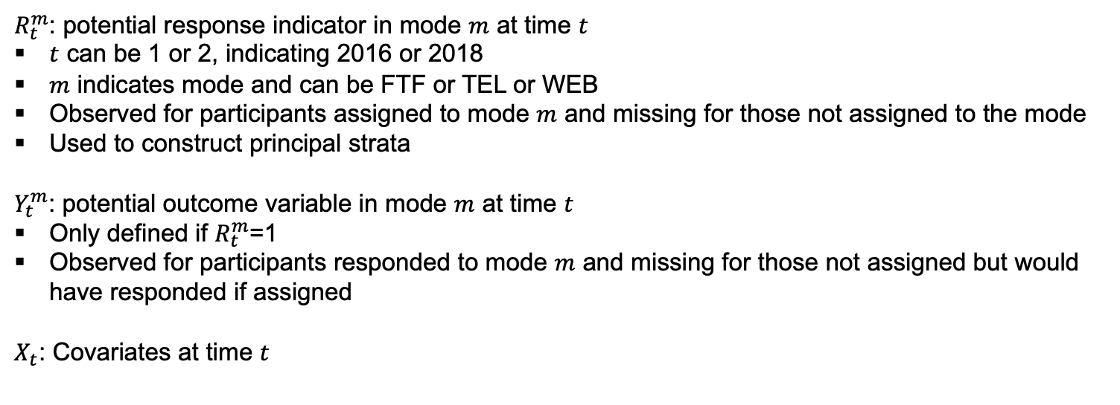
Notations
$R_{t}^{m}$: potential response indicator in mode $m$ at time $t$
$t$ can be 1 or 2, indicating 2016 or 2018
$m$ indicates mode and can be FTF or TEL or WEB
Observed for participants assigned to mode $m$ and missing for those not assigned to the mode
Used to construct principal strata
$Y_{t}^{m}$: potential outcome variable in mode $m$ at time $t$
Only defined if $R_{t}^{m}$=1
Observed for participants responded to mode $m$ and missing for those not assigned but would have responded if assigned
$X_{t}$: Covariates at time $t$
Notes:
For later slides, I am going to introduce some notations here:

Slide 5
Variables and Data
Outcome variables:
Number of words recalled (proxy for cognitive function)
Whether depressed based on CESD scale
Body Mass Index (BMI)
Self-reported health (very good or excellent)
Three Analyses:
2016 cross-sectional analysis
Rs eligible for TEL and FTF
2018 cross-sectional analysis
Rs eligible for WEB, TEL, and FTF
2016-2018 longitudinal analysis
Rs eligible for TEL and FTF
The same sets of covariates are used to predict the response propensity and the outcomes
age, education, gender, race ethnicity, coupled, born in US, vision, and working status
Notes:
We consider four outcome variables: 1) the number of words recalled, a proxy measure for cognitive function, 2) depression status based on scores in the CESD scale, 3) BMI index, and 4) self-reported health.
Three analyses are conducted:
We considered 2016 cross-sectional analysis, using Rs eligible for TEL and FTF modes.
…
We
We use the same set of covariates to predict the response propensity and the outcomes…

Slide 6
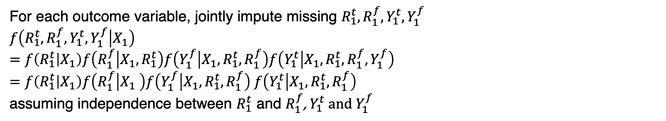
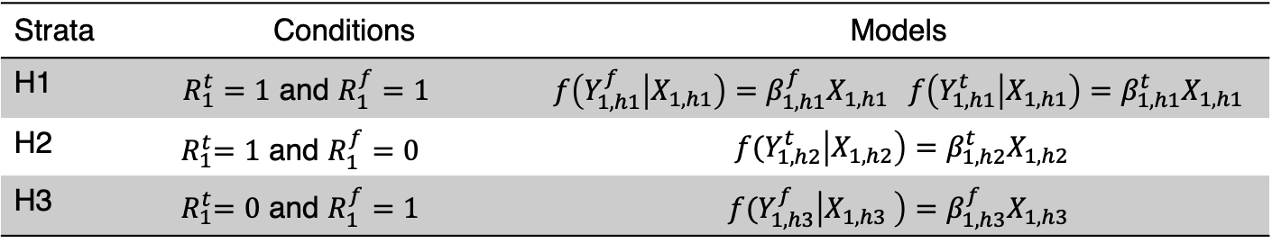
Imputation strategy for HRS 2016
For each outcome variable, jointly impute missing $R_{1}^{t},R_{1}^{f},Y_{1}^{t},Y_{1}^{f}$
$f\left(R_{1}^{t},R_{1}^{f},Y_{1}^{t},Y_{1}^{f} | X_{1}\right)$
$=f\left(R_{1}^{t} | X_{1}\right)f\left(R_{1}^{f} | X_{1},R_{1}^{t}\right)f\left(Y_{1}^{f} | X_{1},R_{1}^{t},R_{1}^{f}\right)f\left(Y_{1}^{t} | X_{1},R_{1}^{t},R_{1}^{f},Y_{1}^{f}\right)$
$=f\left(R_{1}^{t} | X_{1}\right)f\left(R_{1}^{f} | X_{1} \right)f\left(Y_{1}^{f} | X_{1},R_{1}^{t},R_{1}^{f}\right)$ $f\left(Y_{1}^{t} | X_{1},R_{1}^{t},R_{1}^{f}\right)$
assuming independence between $R_{1}^{t}$ and $R_{1}^{f}$, $Y_{1}^{t}$ and $Y_{1}^{f}$
Strata | Conditions | Models
H1 | $R_{1}^{t}=1$ and $R_{1}^{f}=1$ | $$f\left(Y_{1,h1}^{f} | X_{1,h1}\right)=β_{1,h1}^{f}X_{1,h1} f\left(Y_{1,h1}^{t} | X_{1,h1}\right)=β_{1,h1}^{t}X_{1,h1}$$
H2 | ${ R}_{1}^{t}=1$ and $R_{1}^{f}=0$ | $${f(Y}_{1,h2}^{t}\left|X_{1,h2}\right)=β_{1,h2}^{t}X_{1,h2}$$
H3 | ${ R}_{1}^{t}=0$ and $R_{1}^{f}=1$ | $${f(Y}_{1,h3}^{f}\left|X_{1,h3} \right)=β_{1,h3}^{f}X_{1,h3}$$
Notes:
Now, for 2016 analysis, we consider the following imputation strategy:
For each outcome variable, we jointly impute missing $R_{1}^{t},R_{1}^{f},Y_{1}^{t},Y_{1}^{f}$. We assume independence between $R_{1}^{t}$ and $R_{1}^{f}$, $Y_{1}^{t}$ and $Y_{1}^{f}$ and decompose the joint densities into multiple conditional densities to allow iterative sampling. We use Proc MCMC in SAS to implement the models. When impute Y, we consider three principal strata defined by the combinations of the potential response indicators. For example, if a R is predicted to be a respondent for both FTF and TEL, the FTF and the TEL potential outcomes are imputed independently.
If they are only a TEL respondent, which makes them a member of stratum 2, we will only impute their TEL potential outcome. Different models are fitted in each stratum, for each outcome, and for different modes.

Slide 7

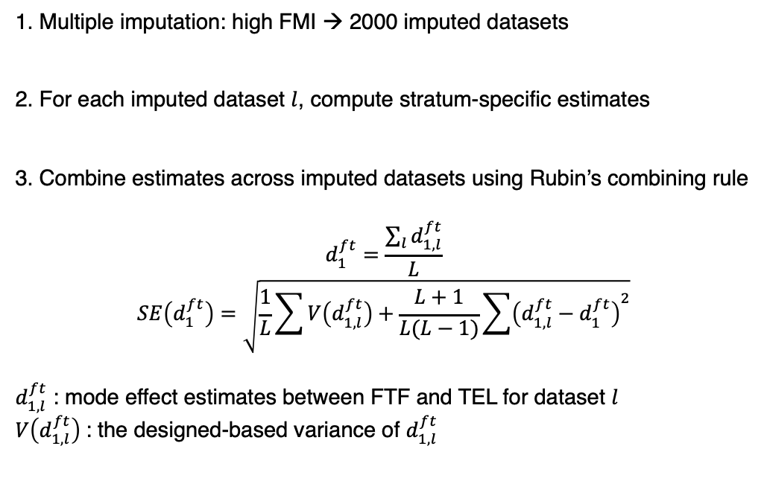
2016 Analysis
1. Multiple imputation: high FMI → 2000 imputed datasets
2. For each imputed dataset $l$, compute stratum-specific estimates
3. Combine estimates across imputed datasets using Rubin’s combining rule
$$d_{1}^{ft}=\frac{\sum_{l}{d_{1,l}^{ft}}}{L}$$
$$SE\left(d_{1}^{ft}\right)=\sqrt{\frac{1}{L}\sum{V\left(d_{1,l}^{ft}\right)+\frac{L+1}{L(L−1)}\sum{{\left(d_{1,l}^{ft}−d_{1}^{ft}\right)}^{2}}}}$$
$d_{1,l}^{ft}$ : mode effect estimates between FTF and TEL for dataset $l$
$V\left(d_{1,l}^{ft}\right)$: the designed-based variance of $d_{1,l}^{ft}$
Imputed data 1
Imputed data 2
Incomplete data
……
Imputed data $L$
Notes:
To account for the typically high fraction of missing information in this type of studies, we used 2000 imputed datasets to propagate the uncertainty. After the imputation, we need to combine the estimates across the imputed datasets, using Rubin’s combining rule, which is shown on this slide.

Slide 8
2016 Analysis
Strata | FTF | TEL | FTF vs. TEL
Number of words recalled
FTF & TEL | 10.41 [0.071] | 10.62 [0.072] | -0.21 [0.079] **
FTF only | 7.80 [0.276]
TEL only |  | 10.65 [0.207]
Depressed
FTF & TEL | 0.13 [0.006] | 0.12 [0.007] | 0.002 [0.009]
FTF only | 0.23 [0.029]
TEL only |  | 0.131 [0.02]
BMI
FTF & TEL | 28.59 [0.146] | 28.36 [0.120] | 0.235 [0.180]
FTF only | 31.05 [0.721]
TEL only |  | 31.06 [0.491]
Self-reported health
FTF & TEL | 0.42 [0.010] | 0.46 [0.010] | -0.04 [0.013]**
FTF only | 0.26 [0.032]
TEL only |  | 0.415 [0.029]
In TEL,
Rs recalled more words and reported better health
Notes:
This slide gives the results of the 2016 analysis. Taking the first outcome for example, we note that for Rs in the first stratum, TEL estimates are higher than the FTF estimates,
In TEL, Rs recalled more words and reported better health
Percentage points

Slide 9

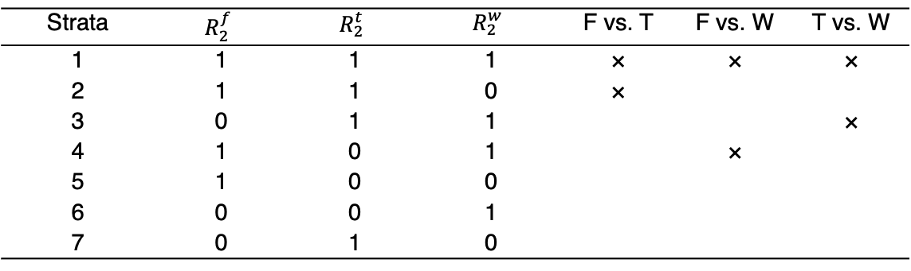
2018 Analysis
For each outcome variable, jointly impute $R_{2}^{t},R_{2}^{f},R_{2}^{w},Y_{2}^{t},Y_{2}^{f},Y_{2}^{w}$
2. For each imputed dataset $l$, compute
1) stratum-specific estimates
2) estimates averaged across strata (weighted by estimated population size of each stratum)
3. Use Rubin’s combining rule to combine estimates across imputed datasets
Strata | $$R_{2}^{f}$$ | $$R_{2}^{t}$$ | $$R_{2}^{w}$$ | F vs. T | F vs. W | T vs. W
1 | 1 | 1 | 1 | × | × | ×
2 | 1 | 1 | 0 | ×
3 | 0 | 1 | 1 |  |  | ×
4 | 1 | 0 | 1 |  | ×
5 | 1 | 0 | 0
6 | 0 | 0 | 1
7 | 0 | 1 | 0
Notes:
After the imputation, what we do?
Stratum-specific estimates, then combine across strata, then combine across imputed datasets.

Slide 10
Strata |  | FTF |  | TEL | WEB |  | WEB | Differences |  |  | Differences
Number of words recalled
F vs. T | 11.61 [0.066] | 11.61 [0.066] | 11.45 [0.086] | 11.45 [0.086] |  |  |  | 0.16 [0.104] | 0.16 [0.104] |  | 0.16 [0.104]
F vs. W | 11.76 [0.276] | 11.76 [0.276] |  |  | 11.55 [0.120] |  | 11.55 [0.120] | 0.20 [0.141] | 0.20 [0.141] |  | 0.20 [0.141]
T vs. W |  |  | 11.47 [0.207] | 11.47 [0.207] | 11.00 [0.114] |  | 11.00 [0.114] | 0.47 [0.137]** | 0.47 [0.137]** |  | 0.47 [0.137]**
Depressed
F vs. T | 0.10 [0.007] | 11.61 [0.066] | 0.10 [0.009] | 0.10 [0.009] |  |  |  | 0.01 [0.011] | 0.01 [0.011] |  | 0.01 [0.011]
F vs. W | 0.11 [0.009] | 11.76 [0.276] |  |  | 0.04 [0.007] |  | 0.04 [0.007] | 0.07 [0.011]*** | 0.07 [0.011]*** |  | 0.07 [0.011]***
T vs. W |  |  | 0.09 [0.012] | 0.09 [0.012] | 0.08 [0.010] |  | 0.08 [0.010] | 0.01 [0.013] | 0.01 [0.013] |  | 0.01 [0.013]
BMI
F vs. T | 28.66 [0.184] | 28.66 [0.184] | 28.72 [0.186] | 28.72 [0.186] |  |  |  | -0.06 [0.283] | -0.06 [0.283] | -0.06 [0.283] | -0.06 [0.283]
F vs. W | 28.91 [0.175] | 28.91 [0.175] |  |  | 28.24 [0.279] | 28.24 [0.279] | 28.24 [0.279] | 0.67 [0.375] | 0.67 [0.375] | 0.67 [0.375] | 0.67 [0.375]
T vs. W |  |  | 28.63 [0.223] | 28.63 [0.223] | 27.27 [0.252] | 27.27 [0.252] | 27.27 [0.252] | 1.36 [0.371]*** | 1.36 [0.371]*** | 1.36 [0.371]*** | 1.36 [0.371]***
Self-reported health
F vs. T | 0.50 [0.010] |  | 0.48 [0.010] |  |  |  |  |  |  |  | 0.02 [0.019]
F vs. W | 0.51 [0.022] |  |  |  |  |  | 0.53 [0.023] |  |  |  | -0.01 [0.027]
T vs. W |  |  | 0.51 [0.020] |  |  |  | 0.54 [0.019] |  |  |  | -0.04 [0.027]
FTF vs. TEL: No evidence
In WEB, Rs
Fewer words (vs. TEL)
Less depressed (vs. FTF)
Lower BMI (vs. TEL)
Notes:
On one hand, these findings about the web mode points to potential larger social desirability bias, which is contrary to the well-known finding that self-administered modes are usually associated with smaller social desirability bias
On one hand, this

Slide 11

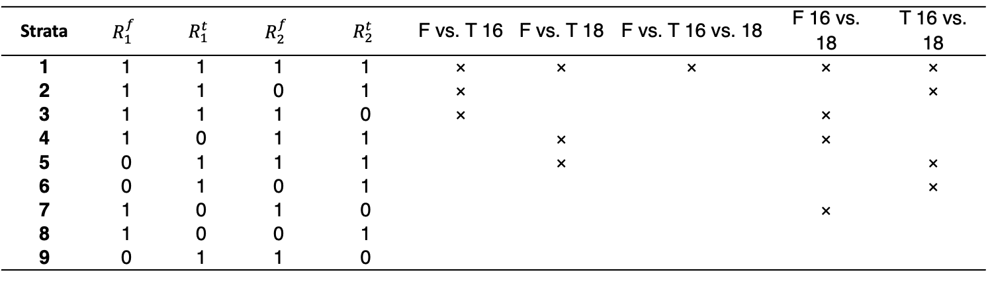
2016-2018 Analysis
For each outcome variable, jointly impute $R_{2}^{t},R_{2}^{f},R_{1}^{t},R_{1}^{f},Y_{2}^{t},Y_{2}^{f},Y_{1}^{t},Y_{1}^{f}$
2. For each imputed dataset $l$,
1) Compute stratum-specific estimates
2) Combine strata for five possible comparisons
3. Use Rubin’s combining rule to combine estimates across imputed datasets
Strata | $$R_{1}^{f}$$ | $$R_{1}^{t}$$ | $$R_{2}^{f}$$ | $$R_{2}^{t}$$ | F vs. T 16 | F vs. T 18 | F vs. T 16 vs. 18 | F 16 vs. 18 | T 16 vs. 18
1 | 1 | 1 | 1 | 1 | × | × | × | × | ×
2 | 1 | 1 | 0 | 1 | × |  |  |  | ×
3 | 1 | 1 | 1 | 0 | × |  |  | ×
4 | 1 | 0 | 1 | 1 |  | × |  | ×
5 | 0 | 1 | 1 | 1 |  | × |  |  | ×
6 | 0 | 1 | 0 | 1 |  |  |  |  | ×
7 | 1 | 0 | 1 | 0 |  |  |  | ×
8 | 1 | 0 | 0 | 1
9 | 0 | 1 | 1 | 0
Notes:
In addition to the mode effect estimates between F and T, we can also examine time effects in F and T

Slide 12
Comparison | F16 | T16 | F18 | T18 | Differences
Number of words recalled
FT1618 | 10.71 [0.089] | 10.94 [0.110] | 11.03 [0.097] | 10.98 [0.105] | 0.28 [0.204]
F1618 | 10.38 [0.091] |  | 10.79 [0.104] |  | 0.405 [0.118]**
T1618 |  | 10.76 [0.124] |  | 10.67 [0.101] | -0.09 [0.150]
Depressed
FT1618 | 0.07 [0.006] | 0.08 [0.006] | 0.08 [0.006] | 0.07 [0.007] | 0.02 [0.015]
F1618 | 0.08 [0.006] |  | 0.09 [0.006] |  | 0.01 [0.008]
T1618 |  | 0.08 [0.006] |  | 0.07 [0.007] | -0.01 [0.009]
BMI
FT1618 | 28.70 [0.223] | 28.70 [0.194] | 28.95 [0.196] | 28.50 [0.333] | 0.45 [0.507]
F1618 | 28.30 [0.197] |  | 28.51 [0.193] |  | 0.21 [0.272]
T1618 |  | 27.98 [0.216] |  | 27.79 [0.234] | -0.19 [0.337]
Self-reported health
FT1618 | 0.46 [0.013] | 0.49 [0.013] | 0.47 [0.013] | 0.42 [0.015] | 0.08 [0.027] **
F1618 | 0.45 [0.012] |  | 0.46 [0.012] |  | 0.01 [0.015]
T1618 |  | 0.48 [0.012] |  | 0.41 [0.014] | -0.075 [0.017]***
Notes:
Significant time effects are only found in FTF for # of words and BMI, and in TEL for self-reported health

Slide 13
Discussion
Mode effects in cross-sectional analysis
FTF vs. TEL: Limited differences
WEB vs. the other two: Some differences
Principal stratification can accommodate different mixed-mode designs
Adaptive mixed-mode designs
Cannot disentangle mode and time effects in this longitudinal design
Need Rs randomly assigned to the same mode across waves
Limitations
The assignment to principal strata depends on the outcome
Account for complex survey designs during analysis phase, not during imputation
Assume no hidden confounders
Notes:
Cannot disentangle – like mentioned earlier.
Ideally, we want some randomized designs so that there are respondents randomly assigned to same mode across waves, if we want to differentiate the time effects and mode effects
However, we also want to admit that my imputation scheme can work in the HRS 2018 analysis because of the randomized design of the web mode. Both points highlight the importance of designs when making inferences.

Slide 14
Thank you!
wenshan.yu@duke.edu

Slide 15
Variables and Data
Outcome variables:
Number of words recalled (proxy for cognitive function)
Whether depressed based on CESD scale
Body Mass Index (BMI)
Self-reported health (very good or excellent)
Three Analyses:
2016 cross-sectional analysis
Rs eligible for TEL and FTF
2018 cross-sectional analysis
Rs eligible for WEB, TEL, and FTF
2016-2018 longitudinal analysis
Rs eligible for TEL and FTF
The same sets of covariates are used to predict the response propensity and the outcomes
age, education, gender, race ethnicity, coupled, born in US, vision, and working status
Notes:
We consider four outcome variables: 1) the number of words recalled, a proxy measure for cognitive function, 2) depression status based on scores in the CESD scale, 3) BMI index, and 4) self-reported health.
Three analyses are conducted:
We considered 2016 cross-sectional analysis, using Rs eligible for TEL and FTF modes.
…
We
We use the same set of covariates to predict the response propensity and the outcomes…

Slide 16
2018 Stratum-specific Results
Number of words recalled
Strata | FTF | TEL | WEB | F vs T | F vs W | T vs W
H1:FTW (5504) | 11.77 [0.072] (2809) | 11.47 [0.095] (1636) | 11.70 [0.120] (1060) | 0.31 [0.120] * | 0.07 [0.142] | -0.24 [0.144]
H2:FT (940) | 10.53 [0.357] (442) | 11.34 [0.325] (498) |  | -0.81 [0.434]
H3:FW (101) | 10.62 [0.685] (95) |  | 2.25 [0.516] (6) |  | 8.37 [0.904]***
H4:TW (413) |  | 11.58 [0.317] (395) | 0.83 [0.109] (18) |  |  | 10.75 [0.327]***
H5: F only (17) | 9.47 [1.802] (17)
H6: T only (67) |  | 8.70 [0.794] (67)
H7: W only (2) |  |  | 12.06 [2.218] (2)
Notes: sample sizes noted in parentheses
Notes:
Stratum-specific estimates.
Most sample are in the first stratum
Estimates in different columns are the mode measurement effects
Estimates in different rows are the mode selection effects

Slide 17
Explanation on 18 results: WEB vs other two modes
I know that studies comparing Web and TEL responses using the control and experimental group data in HRS found that Web responses are generally better than TEL responses. In our studies, we found the opposite conclusion. The reasons might be as follows:
We looked at the full sample that meets the initial eligibility criteria for all three modes. By including respondents who were not assigned to WEB but would have responded to WEB if assigned, we projected a small WEB sample (16 cases) who did not appear to have attempted to provide good responses (recalling close to 0 words) onto a larger group in the full sample, which changed the distribution of WEB responses.
Notes:
Cannot disentangle – like mentioned earlier.
Ideally, we want some randomized designs so that there are respondents randomly assigned to same mode across waves, if we want to differentiate the time effects and mode effects
However, we also want to admit that my imputation scheme can work in the HRS 2018 analysis because of the randomized design of the web mode. Both points highlight the importance of designs when making inferences.

Slide 18
Assumptions
Respondents who responded to a mode other than the one initially assigned would have responded to that mode if they had been assigned to it in the first place.
“monotonicity” assumption
assigning to a mode won’t adversely affect the response propensity
Sequential mixed-mode design (WEB-TEL) and TEL respondents who were assigned to FTF initially
2. Respondents in the same principal stratum share the same association between Y and X
Notes:
Cannot disentangle – like mentioned earlier.
Ideally, we want some randomized designs so that there are respondents randomly assigned to same mode across waves, if we want to differentiate the time effects and mode effects
However, we also want to admit that my imputation scheme can work in the HRS 2018 analysis because of the randomized design of the web mode. Both points highlight the importance of designs when making inferences.

Slide 19
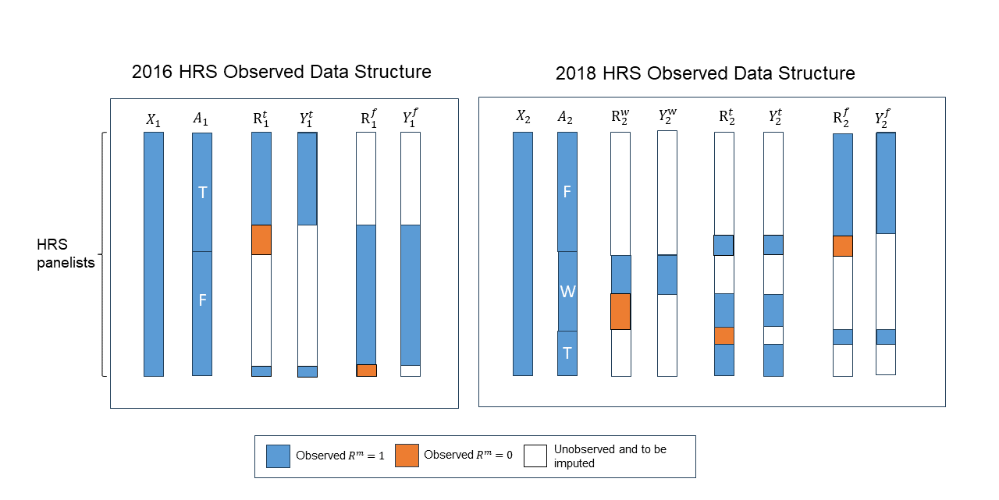
Observed Data Structure
Notes:
What are missing and what are to be imputed
What are the assumptions

Slide 20
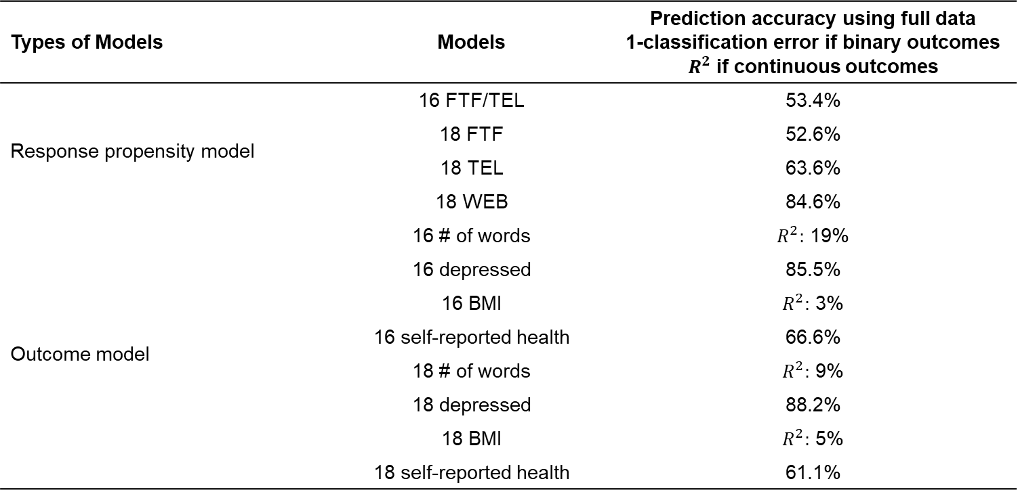
Prediction Power of Models
Types of Models | Models | Prediction accuracy using full data 1-classification error if binary outcomes $R^{2}$ if continuous outcomes
Response propensity model | 16 FTF/TEL | 53.4%
 | 18 FTF | 52.6%
 | 18 TEL | 63.6%
 | 18 WEB | 84.6%
Outcome model | 16 # of words | $R^{2}:$ 19%
 | 16 depressed | 85.5%
 | 16 BMI | $R^{2}:$ 3%
 | 16 self-reported health | 66.6%
 | 18 # of words | $R^{2}:$ 9%
 | 18 depressed | 88.2%
 | 18 BMI | $R^{2}:$ 5%
 | 18 self-reported health | 61.1%
Notes:
Extensions of the current dissertation
Including the new changes
Administrative data

Slide 21
Unweighted Distribution of Outcome Variables in HRS 2016 and 2018
 | 2016 |  | 2018
 | FTF | TEL | FTF | TEL | WEB
# of words | 9.694 | 10.277 | 11.375 | 11.235 | 11.499
Depression | 0.155 | 0.141 | 0.12 | 0.132 | 0.095
BMI | 29.52 | 29.185 | 29.681 | 29.818 | 29.433
Self-reported health | 0.356 | 0.391 | 0.463 | 0.438 | 0.514

Slide 22
Unweighted Distribution of Predictors in HRS 2016 and 2018
 | 2016 |  | 2018
 | FTF | TEL | FTF | TEL | WEB
# of words | 9.694 | 10.277 | 11.375 | 11.235 | 11.499
Depression | 0.155 | 0.141 | 0.12 | 0.132 | 0.095
BMI | 29.52 | 29.185 | 29.681 | 29.818 | 29.433
Self-reported health | 0.356 | 0.391 | 0.463 | 0.438 | 0.514

Slide 23
Unweighted Distribution of Predictors in HRS 2016 and 2018
 | 2016 |  | 2018
 | FTF | TEL | FTF | TEL | WEB
age | 65.55 | 65.694 | 63.561 | 62.158 | 66.11
# of schooling years | 13.463 | 13.503 | 14.236 | 14.114 | 14.42
Male | 0.424 | 0.415 | 0.426 | 0.417 | 0.421
English-speaking Hispanic | 0.172 | 0.156 | 0.069 | 0.089 | 0.054
Non-Hispanic Black | 0.237 | 0.208 | 0.183 | 0.238 | 0.14
Coupled | 0.638 | 0.655 | 0.666 | 0.645 | 0.71
Work | 0.398 | 0.394 | 0.504 | 0.547 | 0.45
Difficulty with Vision | 0.058 | 0.049 | 0.038 | 0.037 | 0.053
Whether US Born | 0.834 | 0.843 | 0.911 | 0.909 | 0.938

Slide 24
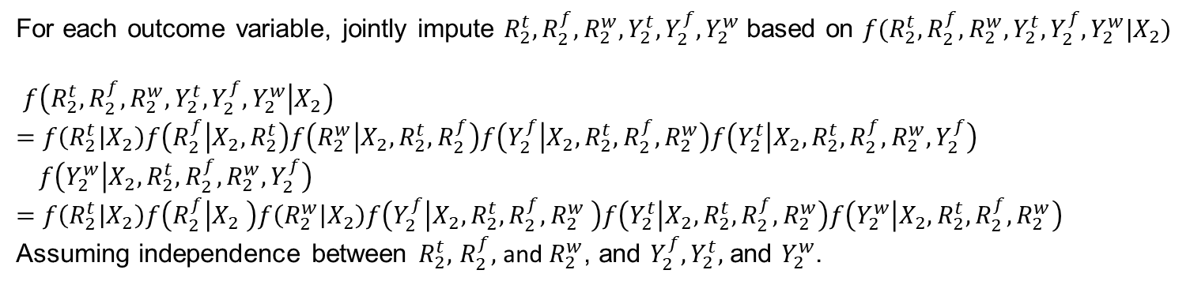
Imputation strategy
2018
For each outcome variable, jointly impute $R_{2}^{t},R_{2}^{f},R_{2}^{w},Y_{2}^{t},Y_{2}^{f},Y_{2}^{w}$ based on $f(R_{2}^{t},R_{2}^{f},R_{2}^{w},Y_{2}^{t},Y_{2}^{f},Y_{2}^{w}|X_{2})$
$f\left(R_{2}^{t},R_{2}^{f},R_{2}^{w},Y_{2}^{t},Y_{2}^{f},Y_{2}^{w} | X_{2}\right)$
$=f\left(R_{2}^{t} | X_{2}\right)f\left(R_{2}^{f} | X_{2},R_{2}^{t}\right)f\left(R_{2}^{w} | X_{2},R_{2}^{t},R_{2}^{f}\right)f\left(Y_{2}^{f} | X_{2},R_{2}^{t},R_{2}^{f},R_{2}^{w}\right)f\left(Y_{2}^{t} | X_{2},R_{2}^{t},R_{2}^{f},R_{2}^{w},Y_{2}^{f}\right)$
$f\left(Y_{2}^{w} | X_{2},R_{2}^{t},R_{2}^{f},R_{2}^{w},Y_{2}^{f}\right)$
$$=f\left(R_{2}^{t} | X_{2}\right)f\left(R_{2}^{f} | X_{2} \right)f\left(R_{2}^{w} | X_{2}\right)f\left(Y_{2}^{f} | X_{2},R_{2}^{t},R_{2}^{f},R_{2}^{w} \right)f\left(Y_{2}^{t} | X_{2},R_{2}^{t},R_{2}^{f},R_{2}^{w}\right)f\left(Y_{2}^{w} | X_{2},R_{2}^{t},R_{2}^{f},R_{2}^{w}\right)$$
Assuming independence between $R_{2}^{t},$ $R_{2}^{f},$ and $R_{2}^{w}$, and $Y_{2}^{f}, Y_{2}^{t},$ and $Y_{2}^{w}$.
Notes:
How to impute:
Impute the response indicators
Impute the potential outcomes

Slide 25
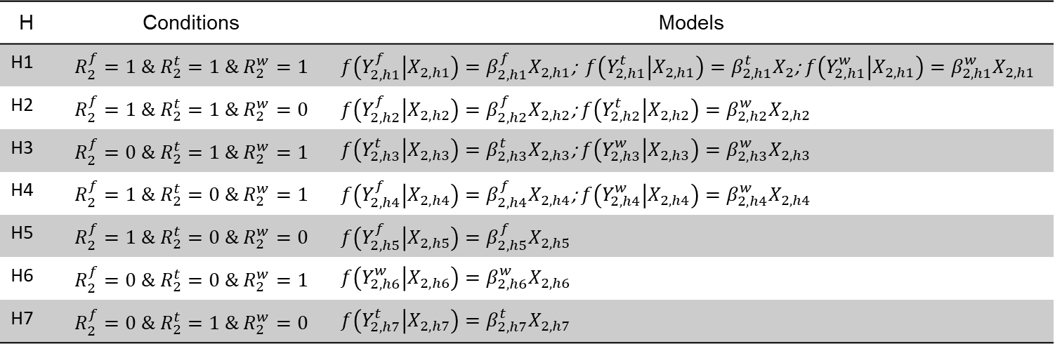
Imputation strategy
2018
For this part $f\left(Y_{2}^{f} | X_{2},R_{2}^{t},R_{2}^{f},R_{2}^{w} \right)f\left(Y_{2}^{t} | X_{2},R_{2}^{t},R_{2}^{f},R_{2}^{w}\right)f\left(Y_{2}^{w} | X_{2},R_{2}^{t},R_{2}^{f},R_{2}^{w}\right),$ we specify different models depending on the principal strata defined by the potential response indicators
H | Conditions | Models
H1 | $$R_{2}^{f}=1 \& R_{2}^{t}=1 \& R_{2}^{w}=1$$ | $f\left(Y_{2,h1}^{f} | X_{2,h1}\right)=β_{2,h1}^{f}X_{2,h1}$; $f\left(Y_{2,h1}^{t} | X_{2,h1}\right)=β_{2,h1}^{t}X_{2}$; $f\left(Y_{2,h1}^{w} | X_{2,h1}\right)=β_{2,h1}^{w}X_{2,h1}$
H2 | $$R_{2}^{f}=1 \& R_{2}^{t}=1 \& R_{2}^{w}=0$$ | $f\left(Y_{2,h2}^{f} | X_{2,h2}\right)=β_{2,h2}^{f}X_{2,h2}$; $f\left(Y_{2,h2}^{t} | X_{2,h2}\right)=β_{2,h2}^{w}X_{2,h2}$
H3 | $$R_{2}^{f}=0 \& R_{2}^{t}=1 \& R_{2}^{w}=1$$ | $f\left(Y_{2,h3}^{t} | X_{2,h3}\right)=β_{2,h3}^{t}X_{2,h3}$; $f\left(Y_{2,h3}^{w} | X_{2,h3}\right)=β_{2,h3}^{w}X_{2,h3}$
H4 | $$R_{2}^{f}=1 \& R_{2}^{t}=0 \& R_{2}^{w}=1$$ | $f\left(Y_{2,h4}^{f} | X_{2,h4}\right)=β_{2,h4}^{f}X_{2,h4}$; $f\left(Y_{2,h4}^{w} | X_{2,h4}\right)=β_{2,h4}^{w}X_{2,h4}$
H5 | $$R_{2}^{f}=1 \& R_{2}^{t}=0 \& R_{2}^{w}=0$$ | $f\left(Y_{2,h5}^{f} | X_{2,h5}\right)=β_{2,h5}^{f}X_{2,h5}$
H6 | $$R_{2}^{f}=0 \& R_{2}^{t}=0 \& R_{2}^{w}=1$$ | $f\left(Y_{2,h6}^{w} | X_{2,h6}\right)=β_{2,h6}^{w}X_{2,h6}$
H7 | $$R_{2}^{f}=0 \& R_{2}^{t}=1 \& R_{2}^{w}=0$$ | $f\left(Y_{2,h7}^{t} | X_{2,h7}\right)=β_{2,h7}^{t}X_{2,h7}$
Notes:
For outcome imputation, we consider 7 mutually exclusive strata. People who can respond to all three modes, all three outcomes would be imputed
For people who can only respond to one mode or two modes, potential outcomes for those modes would be imputed. In different strata, data used to estimate the multivariate relationship is different, beta coefficients are also different.

Slide 26
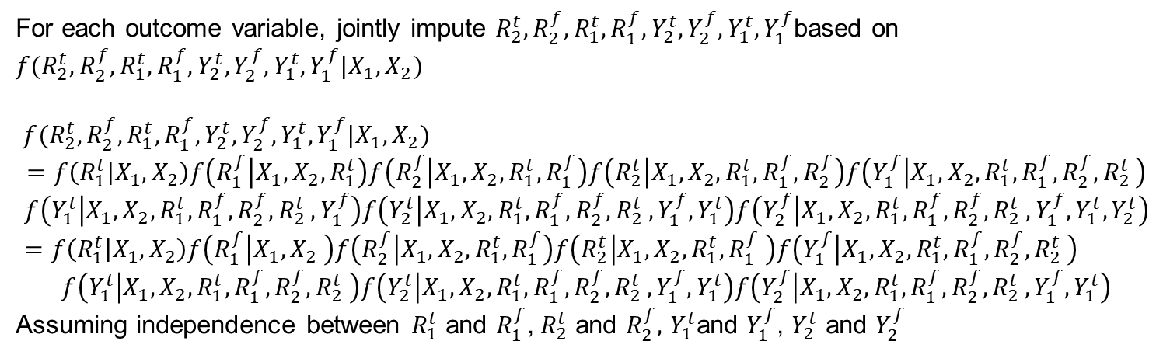
Imputation strategy
2016-2018
For each outcome variable, jointly impute $R_{2}^{t},R_{2}^{f},R_{1}^{t},R_{1}^{f},Y_{2}^{t},Y_{2}^{f},Y_{1}^{t},Y_{1}^{f}$based on $f(R_{2}^{t},R_{2}^{f},R_{1}^{t},R_{1}^{f},Y_{2}^{t},Y_{2}^{f},Y_{1}^{t},Y_{1}^{f}|{X_{1},X}_{2})$
$f(R_{2}^{t},R_{2}^{f},R_{1}^{t},R_{1}^{f},Y_{2}^{t},Y_{2}^{f},Y_{1}^{t},Y_{1}^{f}|{X_{1},X}_{2})$
$$=f\left(R_{1}^{t} | X_{1},X_{2}\right)f\left(R_{1}^{f} | X_{1},X_{2},R_{1}^{t}\right)f\left(R_{2}^{f} | X_{1},X_{2},R_{1}^{t},R_{1}^{f}\right)f\left(R_{2}^{t} | X_{1},X_{2},R_{1}^{t},R_{1}^{f},R_{2}^{f}\right)f\left(Y_{1}^{f} | X_{1},X_{2},R_{1}^{t},R_{1}^{f},R_{2}^{f}{,R}_{2}^{t}\right)$$
$$f\left(Y_{1}^{t} | X_{1},X_{2},R_{1}^{t},R_{1}^{f},R_{2}^{f}{,R}_{2}^{t},Y_{1}^{f}\right)f\left(Y_{2}^{t} | X_{1},X_{2},R_{1}^{t},R_{1}^{f},R_{2}^{f}{,R}_{2}^{t},Y_{1}^{f},Y_{1}^{t}\right)f\left(Y_{2}^{f} | X_{1},X_{2},R_{1}^{t},R_{1}^{f},R_{2}^{f}{,R}_{2}^{t},Y_{1}^{f},Y_{1}^{t},Y_{2}^{t}\right)=f\left(R_{1}^{t} | X_{1},X_{2}\right)f\left(R_{1}^{f} | X_{1},X_{2} \right)f\left(R_{2}^{f} | X_{1},X_{2},R_{1}^{t},R_{1}^{f}\right)f\left(R_{2}^{t} | X_{1},X_{2},R_{1}^{t},R_{1}^{f} \right)f\left(Y_{1}^{f} | X_{1},X_{2},R_{1}^{t},R_{1}^{f},R_{2}^{f}{,R}_{2}^{t}\right)$$
$$f\left(Y_{1}^{t} | X_{1},X_{2},R_{1}^{t},R_{1}^{f},R_{2}^{f}{,R}_{2}^{t} \right)f\left(Y_{2}^{t} | X_{1},X_{2},R_{1}^{t},R_{1}^{f},R_{2}^{f}{,R}_{2}^{t},Y_{1}^{f},Y_{1}^{t}\right)f\left(Y_{2}^{f} | X_{1},X_{2},R_{1}^{t},R_{1}^{f},R_{2}^{f}{,R}_{2}^{t},Y_{1}^{f},Y_{1}^{t}\right)$$
Assuming independence between $R_{1}^{t}$ and $R_{1}^{f}$, $R_{2}^{t}$ and $R_{2}^{f},$ $Y_{1}^{t}$and $Y_{1}^{f}$, $Y_{2}^{t}$ and $Y_{2}^{f}$
Notes:
Focus on F and T mode differences across waves

Slide 27
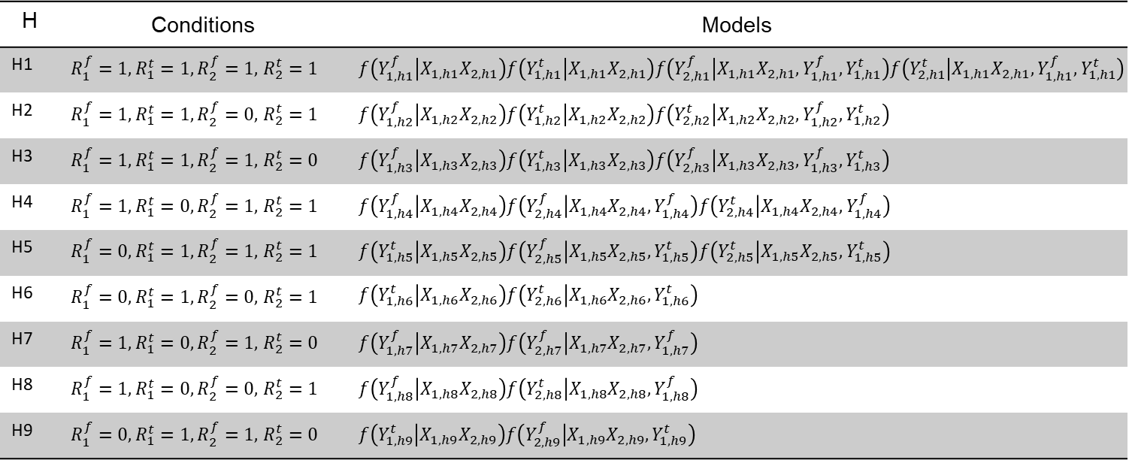
Imputation strategy
2016-2018
H | Conditions | Models
H1 | $R_{1}^{f}=1, R_{1}^{t}=1, R_{2}^{f}=1,$ $R_{2}^{t}=1$ | $f\left(Y_{1,h1}^{f} | X_{1,h1}X_{2,h1}\right)f\left(Y_{1,h1}^{t} | X_{1,h1}X_{2,h1}\right)f\left(Y_{2,h1}^{f} | X_{1,h1}X_{2,h1},Y_{1,h1}^{f},Y_{1,h1}^{t}\right)f\left(Y_{2,h1}^{t} | X_{1,h1}X_{2,h1},Y_{1,h1}^{f},Y_{1,h1}^{t}\right)$
H2 | $R_{1}^{f}=1, R_{1}^{t}=1, R_{2}^{f}=0,$ $R_{2}^{t}=1$ | $f\left(Y_{1,h2}^{f} | X_{1,h2}X_{2,h2}\right)f\left(Y_{1,h2}^{t} | X_{1,h2}X_{2,h2}\right)f\left(Y_{2,h2}^{t} | X_{1,h2}X_{2,h2},Y_{1,h2}^{f},Y_{1,h2}^{t}\right)$
H3 | $R_{1}^{f}=1, R_{1}^{t}=1, R_{2}^{f}=1,$ $R_{2}^{t}=0$ | $f\left(Y_{1,h3}^{f} | X_{1,h3}X_{2,h3}\right)f\left(Y_{1,h3}^{t} | X_{1,h3}X_{2,h3}\right)f\left(Y_{2,h3}^{f} | X_{1,h3}X_{2,h3},Y_{1,h3}^{f},Y_{1,h3}^{t}\right)$
H4 | $R_{1}^{f}=1, R_{1}^{t}=0, R_{2}^{f}=1,$ $R_{2}^{t}=1$ | $f\left(Y_{1,h4}^{f} | X_{1,h4}X_{2,h4}\right)f\left(Y_{2,h4}^{f} | X_{1,h4}X_{2,h4},Y_{1,h4}^{f}\right)f\left(Y_{2,h4}^{t} | X_{1,h4}X_{2,h4},Y_{1,h4}^{f}\right)$
H5 | $R_{1}^{f}=0, R_{1}^{t}=1, R_{2}^{f}=1,$ $R_{2}^{t}=1$ | $f\left(Y_{1,h5}^{t} | X_{1,h5}X_{2,h5}\right)f\left(Y_{2,h5}^{f} | X_{1,h5}X_{2,h5}, Y_{1,h5}^{t}\right)f\left(Y_{2,h5}^{t} | X_{1,h5}X_{2,h5}, Y_{1,h5}^{t}\right)$
H6 | $R_{1}^{f}=0, R_{1}^{t}=1, R_{2}^{f}=0,$ $R_{2}^{t}=1$ | $f\left(Y_{1,h6}^{t} | X_{1,h6}X_{2,h6}\right)f\left(Y_{2,h6}^{t} | X_{1,h6}X_{2,h6}, Y_{1,h6}^{t}\right)$
H7 | $R_{1}^{f}=1, R_{1}^{t}=0, R_{2}^{f}=1,$ $R_{2}^{t}=0$ | $f\left(Y_{1,h7}^{f} | X_{1,h7}X_{2,h7}\right)f\left(Y_{2,h7}^{f} | X_{1,h7}X_{2,h7},Y_{1,h7}^{f}\right)$
H8 | $R_{1}^{f}=1, R_{1}^{t}=0, R_{2}^{f}=0,$ $R_{2}^{t}=1$ | $f\left(Y_{1,h8}^{f} | X_{1,h8}X_{2,h8}\right)f\left(Y_{2,h8}^{t} | X_{1,h8}X_{2,h8},Y_{1,h8}^{f}\right)$
H9 | $R_{1}^{f}=0, R_{1}^{t}=1, R_{2}^{f}=1,$ $R_{2}^{t}=0$ | $f\left(Y_{1,h9}^{t} | X_{1,h9}X_{2,h9}\right)f\left(Y_{2,h9}^{f} | X_{1,h9}X_{2,h9}, Y_{1,h9}^{t}\right)$
Notes:
More principal strata considered in the longitudinal studies

